Slide 1


SMART INDIA HACKATHON 2026
Problem Statement ID | SIH26044
Problem Statement Title | Intelligent platform for skill mapping, gap analysis, learning pathways and opportunity matching
Theme | Education & Skill Development
PS Category | Software
Team Members | Sidhartha Champati (25CSE121) Ayush Goud (25CSE095) Prasanna Mathan (25CSE073) Subham Dashmohapatra (25CSE079) Santosh Pradhan (25CSE074) Rutumbhara Sahu (25CSE017)

Slide 2



SKILLBRIDGE AI - PROPOSED SOLUTION
Idea / Solution
Addressing the Problem
Innovation & Uniqueness
From a generic portal to an intelligent skill-readiness platform.
Students: Clarifies exact skills employers expect, removing guesswork.
Explainable matching: Transparently shows why a candidate matches a specific role.
SkillBridge AI is a unified platform connecting students, industry, academicians, and institutions. It moves beyond listing jobs to actively improving candidate readiness.
Employers: Solves the struggle to identify candidates with the right competency mix.
Skill-gap-to-roadmap: Translates missing competencies into actionable learning steps.
Institutions: Provides an integrated view of skill gaps, industry demand, and placement readiness.
Core Workflow: Assess → Diagnose → Improve → Verify → Match → Track
Skill Passport: Creates a digital portfolio with tiered evidence and verification levels.
Institution-level Intelligence: Dashboard analytics for macro-level curriculum adjustments.
@SIH Idea submission- Template 2 Internal Hackathon 2026

Slide 3
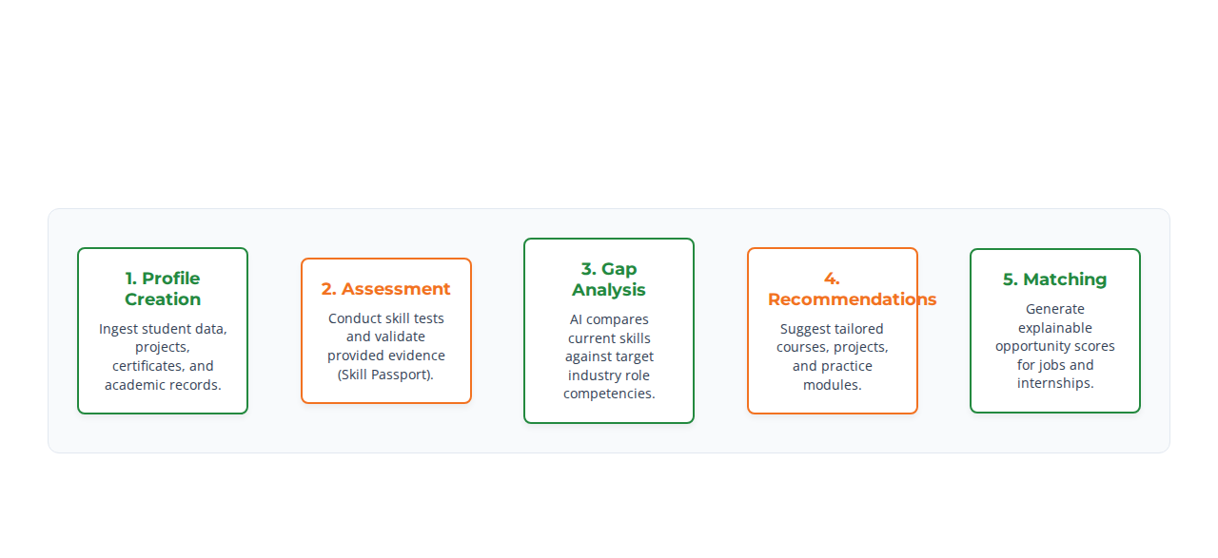




TECHNICAL APPROACH
Technologies to be used
Methodology and Implementation Process
@SIH Idea submission- Template 3 Internal Hackathon 2026

Slide 4



FEASIBILITY AND VIABILITY
Feasibility Analysis
Potential Challenges
Mitigation Strategies
Modular Architecture: Allows delivery of a working MVP first, scaling complex features later.
Data Quality & Availability: Reliance on accurate institutional data and competency mappings.
Data Strategy: Start with curated/demo datasets; build robust ingestion interfaces for later verified integration.
Phase 1: MVP (Profiles, Assessment, Basic Matching)
AI Matching Errors: Risk of algorithms incorrectly scoring or misinterpreting candidate skills.
AI Transparency: Implement explainable rules and a human-in-the-loop review mechanism for matching logic.
Phase 2: Intelligence (Advanced Gap Analysis)
Data Privacy: Handling sensitive student academic and personal data securely.
Phase 3: Verification (Skill Passport)
Security Protocol: Enforce strict Role-Based Access Control (RBAC), JWT authentication, and secure document storage.
Scope Creep: Overcomplicating the platform before core mechanics work.
Phase 4: Scale
Economic Viability: Primarily software-based utilizing open-source technologies to drastically reduce development costs.
MVP-First Design: Stick strictly to Phase 1 deliverables for the hackathon prototype.

Slide 5


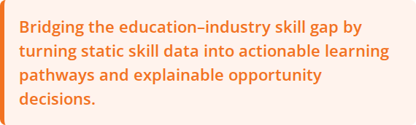


IMPACT AND BENEFITS
Core Impact Target
Students
Industry
Understand personal strengths & gaps. Receive personalized learning paths and build a verified digital portfolio.
Define clear competency requirements. Find better-fit candidates faster and accurately track the hiring pipeline.
One unified platform creates compounding value. As students improve their readiness through targeted upskilling, industry matching becomes more efficient, leading to better hiring pipelines and institutional placement records.
Academia
Institutions
Gain visibility into current industry skill demands. Improve curriculum alignment and support effective mentorship.
Monitor cohort skill development. Identify critical learning gaps and utilize analytics for strategic placement planning.
@SIH Idea submission- Template 5 Internal Hackathon 2026

Slide 6

RESEARCH AND REFERENCES
Frameworks and Research Base
Government & Competency Frameworks
AI/ML & Industry Research
SIH26044 Documentation: Adherence to the core problem statement, guidelines, and expected outcomes provided by the Ministry.
Skill Extraction: Research on NLP-based Named Entity Recognition (NER) for accurate skill extraction from unstructured text (resumes/syllabi).
NSQF Alignment: Integration methodologies based on the National Skill Qualification Framework (NSQF) to standardize competency evaluation.
Semantic Matching: Implementation of semantic similarity algorithms and vector embeddings for high-accuracy role matching.
Public Datasets: Utilization of approved government skill-development and employment datasets for baseline modeling.
Industry Matrices: Analysis of employer-defined role competency matrices to structure the platform's gap analysis logic.
Explainable AI (XAI): Frameworks ensuring recommendation scoring remains transparent to the end-users.

